Slide 1
Architecture deployment approaches - I
Pravin Y Pawar

Slide 2
Architecture approaches
Understanding existing approaches to architecting enterprise apps helps clarify the role played by Serverless
Many approaches and patterns that evolved over decades of software development
all have their own pros and cons
In many cases, the ultimate solution may not involve deciding on a single approach but may integrate several approaches
Migration scenarios often involve shifting from one architecture approach to another through a hybrid approach
Common approaches
Monoliths
N-layer
Microservices etc.

Slide 3
Architecture deployment approaches
Regardless of the architecture approach used to design a business application,
the implementation, or deployment of those applications may vary
Businesses host applications on everything from physical hardware to Serverless functions
Conventional deployment patterns
N-Tier applications
On-premises and Infrastructure as a Service (IaaS)
Platform as a Service (PaaS)
Software as a Service (SaaS)
Modern deployment patterns
Containers and Functions as a Service (Caas and FaaS)
Serverless

Slide 4
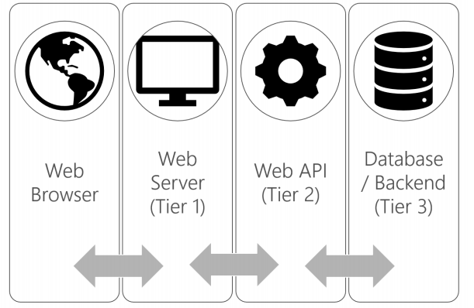
N-Tier applications
Mature architecture
Refers to applications that separate various logical layers into separate physical tiers
A physical implementation of N-Layer architecture
The most common implementations:
A presentation tier, for example a web app
An API or data access tier, such as a REST API
A data tier, such as a SQL database
Characteristics:
Projects are typically aligned with tiers
Testing may be approached differently by tier.
Tiers provide layers of abstraction
Typically, layers only interact with adjacent layers.
Releases are often managed at the project, and therefore tier, level.
A simple API change may require a new release of an entire middle tier
source : Microsoft

Slide 5
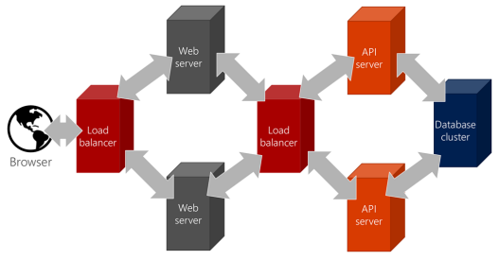
On-premises
On-premise hosting
The traditional approach to hosting applications requires
buying hardware
managing all of the software installations, including the operating system
Originally this involved expensive data centers and physical hardware
The challenges that come with operating physical hardware are many, including:
The need to buy excess for “just in case” or peak demand scenarios
Securing physical access to the hardware
Responsibility for hardware failure (such as disk failure)
Cooling
Configuring routers and load balancers
Power redundancy
Securing software access
source : Microsoft

Slide 6
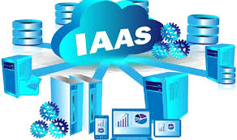
Infrastructure as a Service (IaaS)
Virtualization of hardware, via “virtual machines” enables Infrastructure as a Service (IaaS)
Host machines are effectively partitioned to provide resources to instances with allocations for their own memory, CPU, and storage
The team provisions the necessary VMs and configures the associated networks and access to storage.
Although virtualization and Infrastructure as a Service (IaaS) address many concerns
still leaves much responsibility in the hands of the infrastructure team
The team maintains
operating system versions
applies security patches
installs third-party dependencies on the target machines
Although many organizations deploy N-Tier applications to these targets, many companies benefit from deploying to a more cloud native model such as Platform as a Service.
source:FileCloud

Slide 7
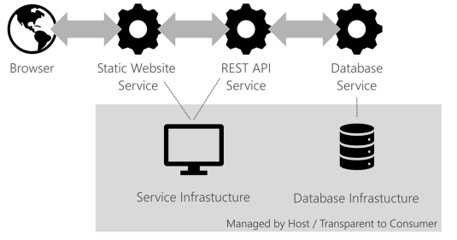
Platform as a Service (PaaS)
Offers configured solutions that developers can plug into directly
Another term for managed hosting
Eliminates the need to manage the base operating system, security patches and in many cases any third-party dependencies
Examples of platforms include web applications, databases, and mobile back ends
Allows the developer to focus on the code or database schema rather than how it gets deployed
Benefits of PaaS include:
Pay for use models that eliminate the overhead of investing in idle machines
Direct deployment and improved DevOps, continuous integration (CI), and continuous delivery (CD) pipelines
Automatic upgrades, updates, and security patches
Push-button scale out and scale up (elastic scale)
The main disadvantage of PaaS traditionally has been vendor lock-in
source : Microsoft

Slide 8
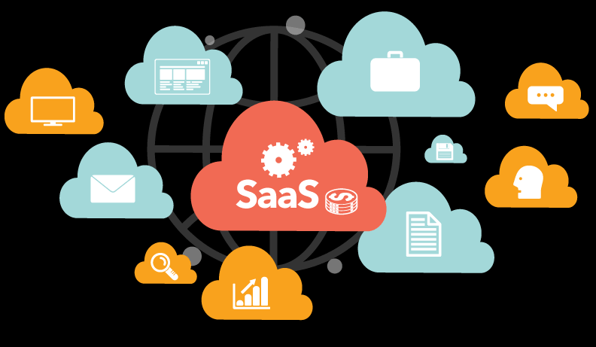
Software as a Service (SaaS)
Is centrally hosted and available without local installation or provisioning
Often is hosted on top of PaaS as a platform for deploying software
Provides services to run and connect with existing software
Often industry and vertical specific
Often licensed and typically provides a client/server model
Most modern SaaS offerings use web-based apps for the client
Companies typically consider SaaS as a business solution to license offerings
Most SaaS solutions are built on IaaS, PaaS, and/or Serverless back ends
Source:brainwire

Slide 9
Thank You!
Reference:
Serverless apps Architecture patterns and Azure implementation
By Microsoft
In our next session:

